Slide 1
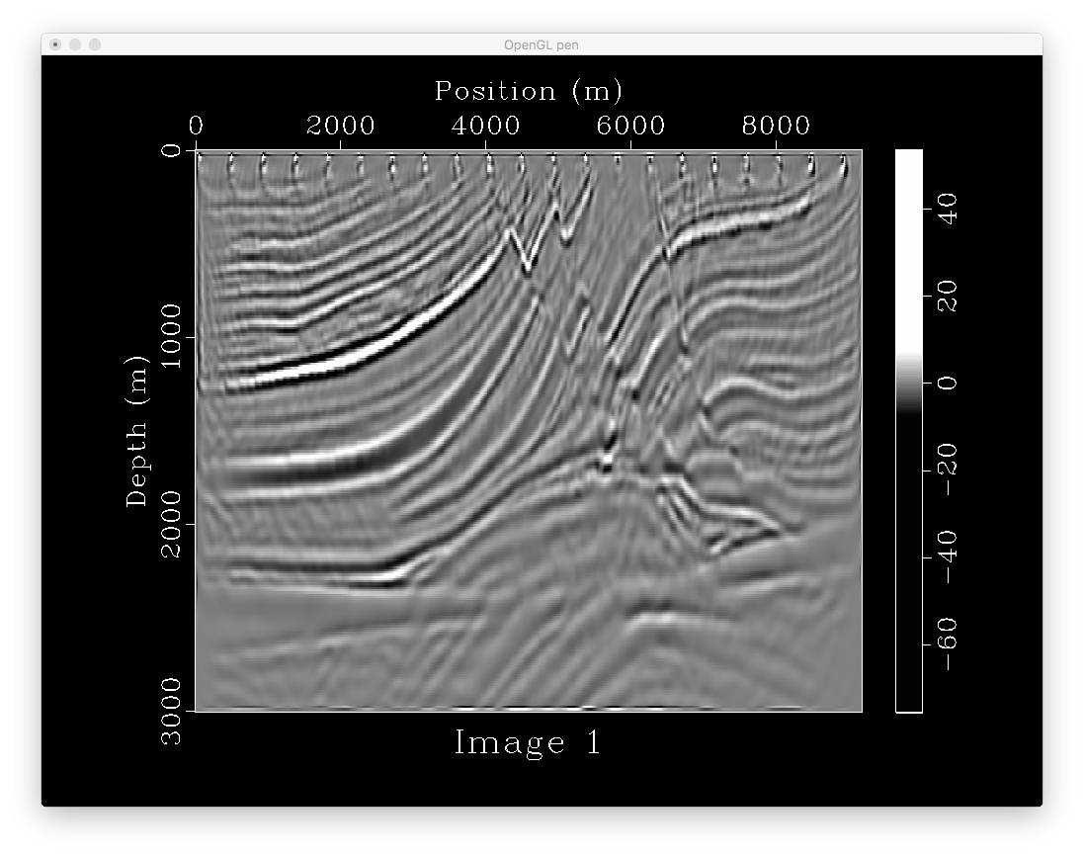
251*767
21 shots
0.0012*3000
with tpow

Slide 2
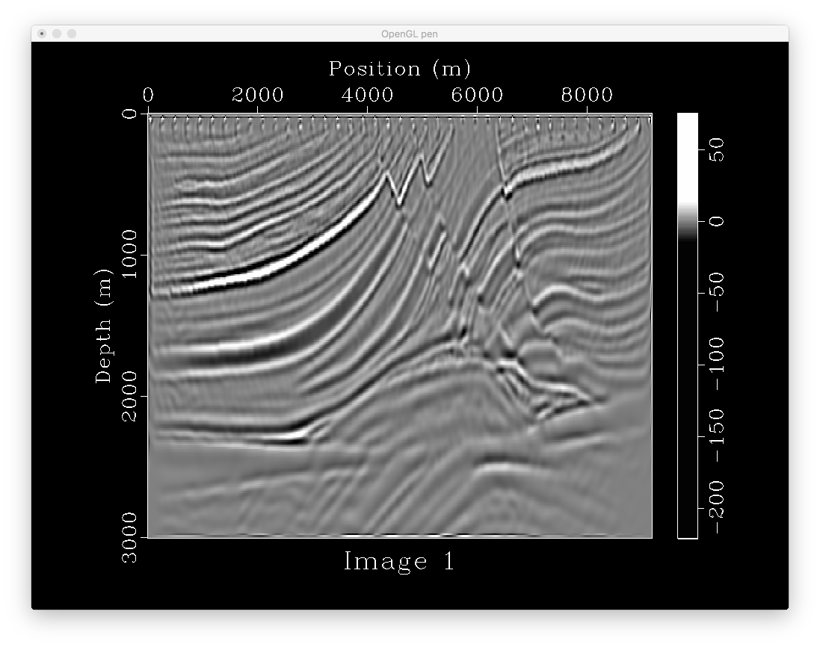
251*767
41 shots
0.0012*3000
with tpow

Slide 3

251*767
41 shots
0.0012*3800
with tpow
Longer time
record makes
no difference

Slide 4
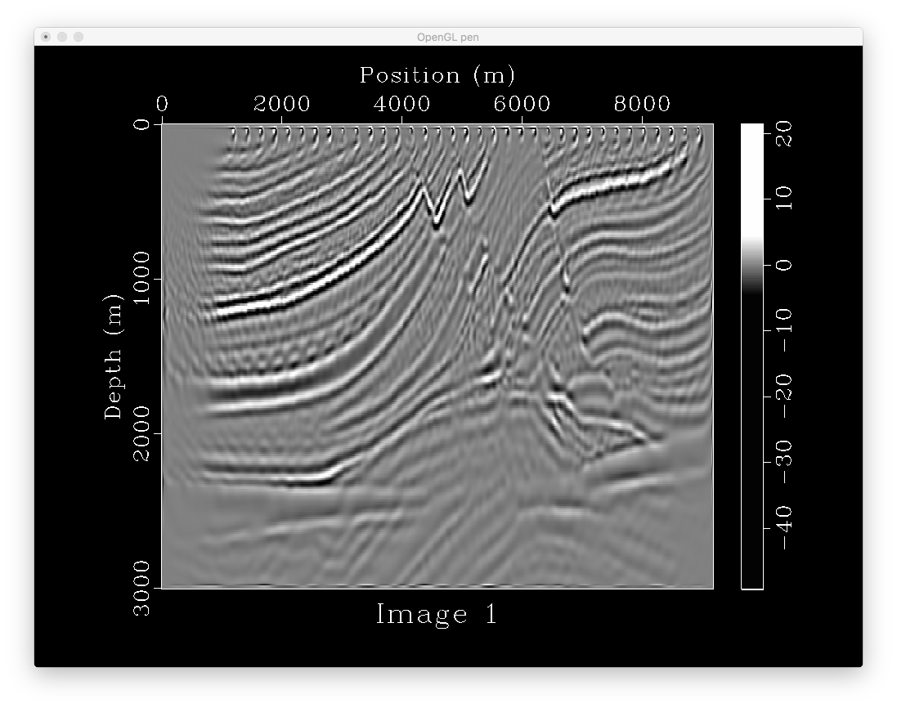
251*767
36 shots
0.0012*3000
Rolling acqusition
Ng=100
with tpow
Rolling shooting
Introduce acquisition
Footprint (window
Overlapping)

Slide 5
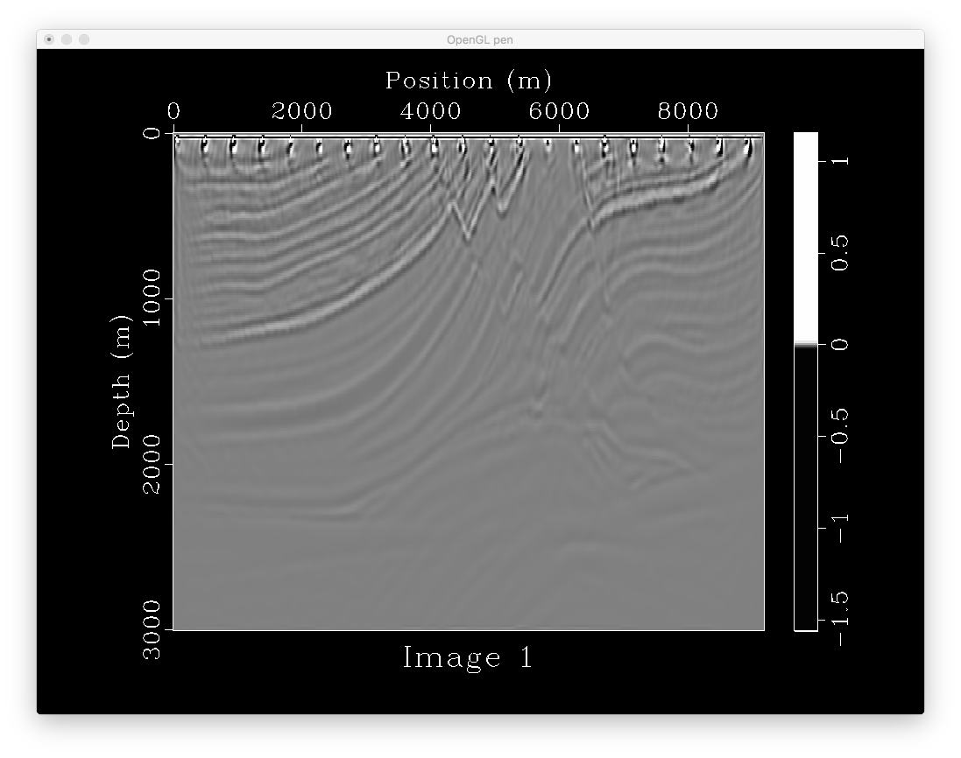
251*767
21 shots
0.0012*3000
without tpow

Slide 6
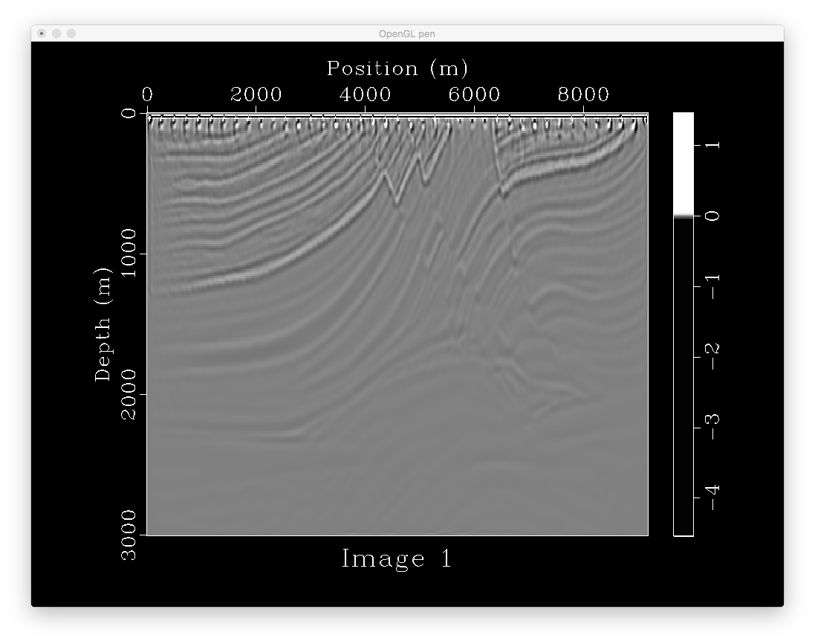
251*767
41 shots
0.0012*3000
without tpow

Slide 7
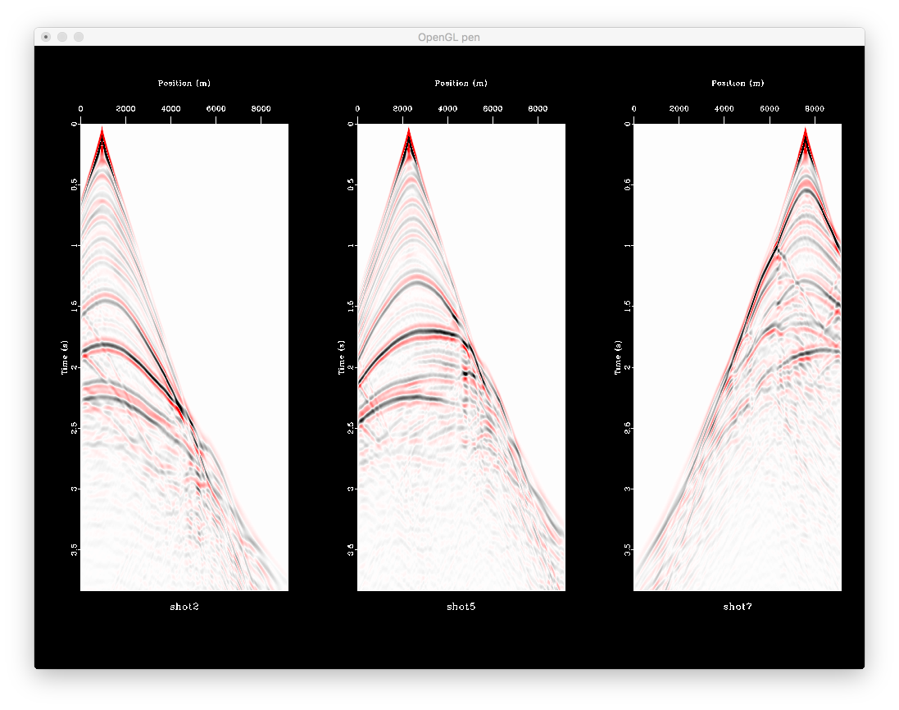

Slide 8
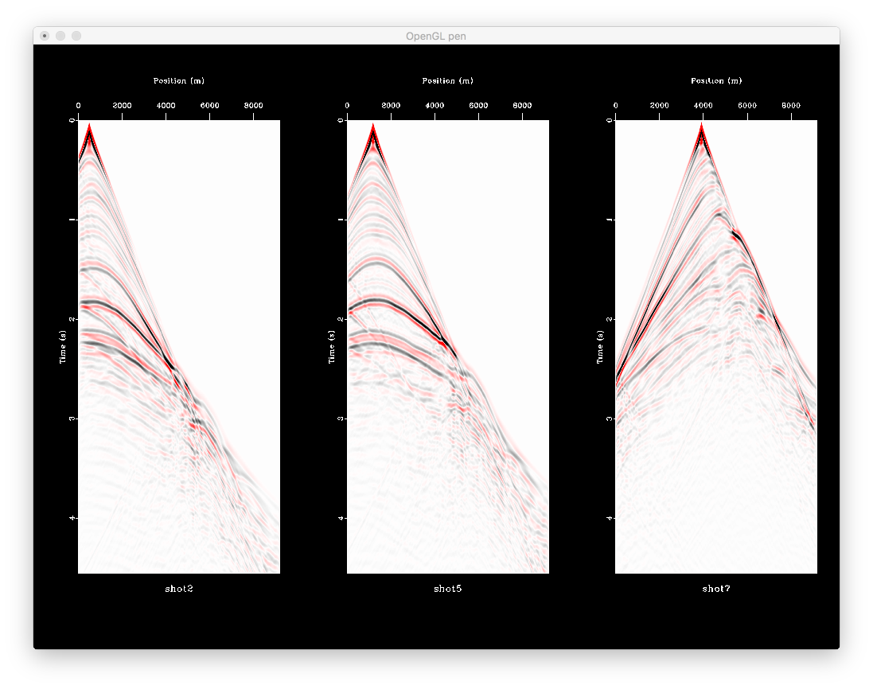

Slide 9
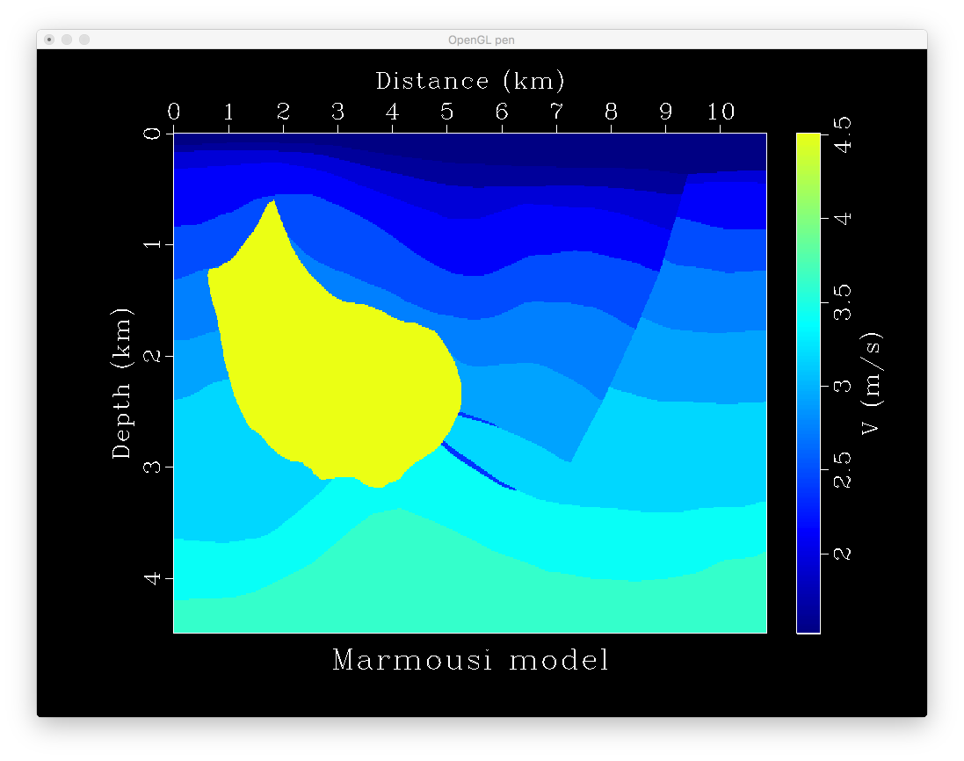

Slide 10
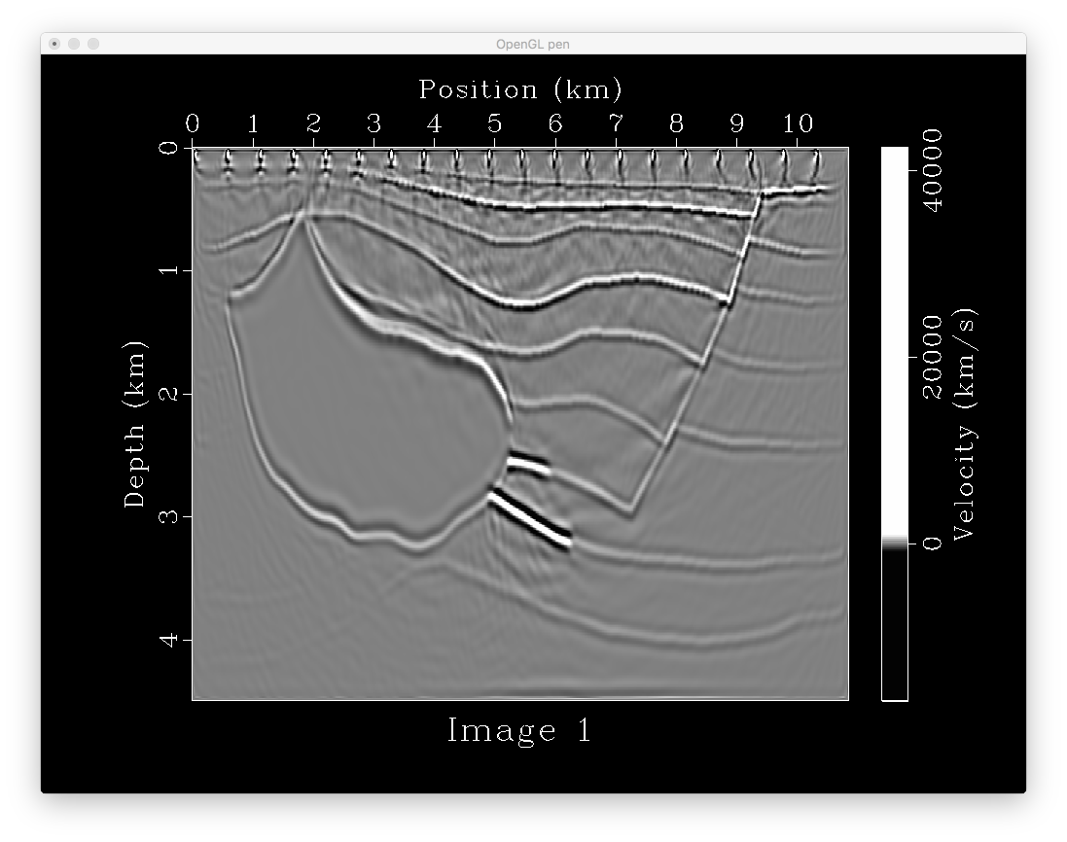
375*905
21 shots
0.0015*4000
with tpow

Slide 11

375*905
61 shots
0.0015*4000
with tpow

Slide 12

375*905
87 shots
0.0015*4000
with tpow
With left and
Right extension

Slide 13

375*905
87 shots
0.0015*4000
with tpow
With left and
Right extension
original size

Slide 14
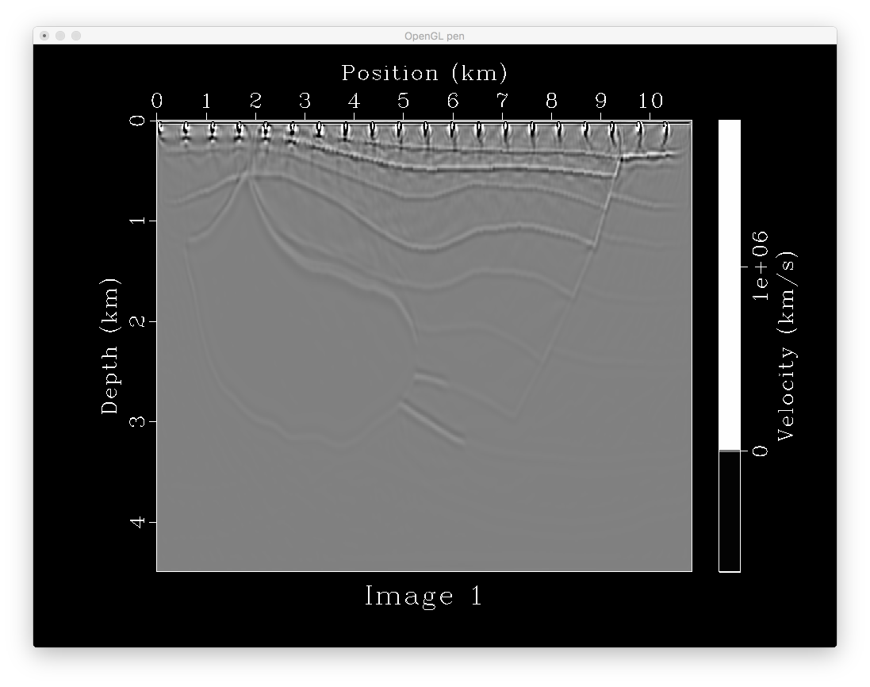
375*905
21 shots
0.0015*4000
without tpow

Slide 15

375*905
61 shots
0.0015*4000
without tpow

Slide 16
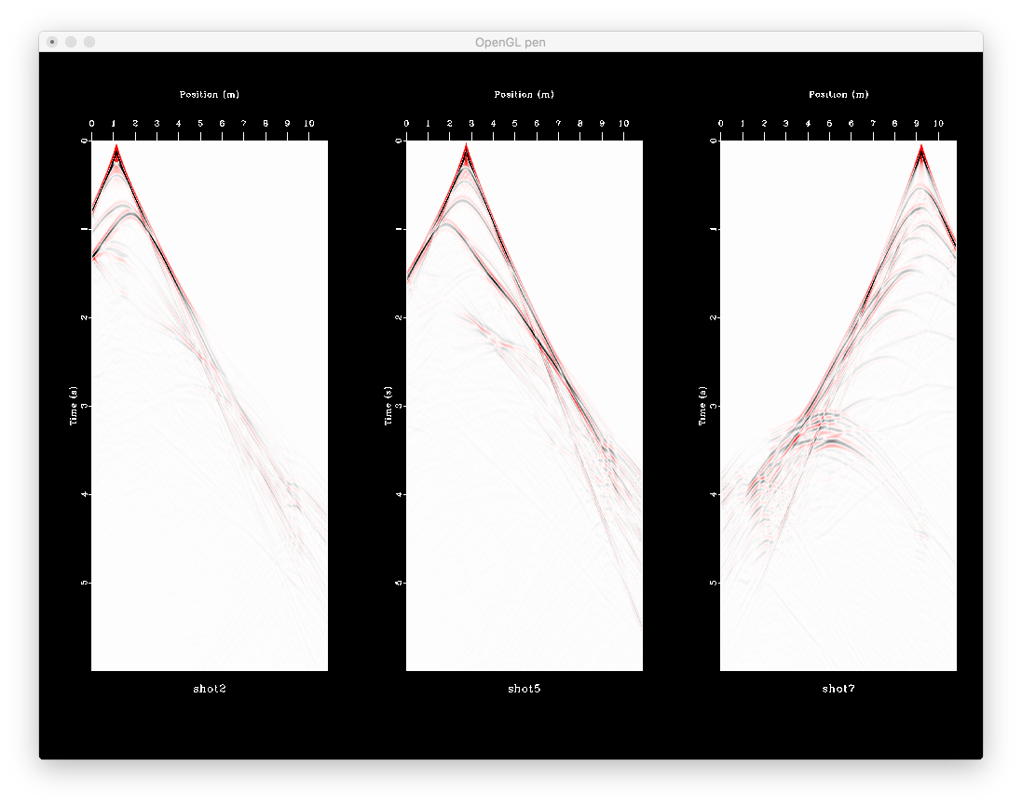

Slide 17
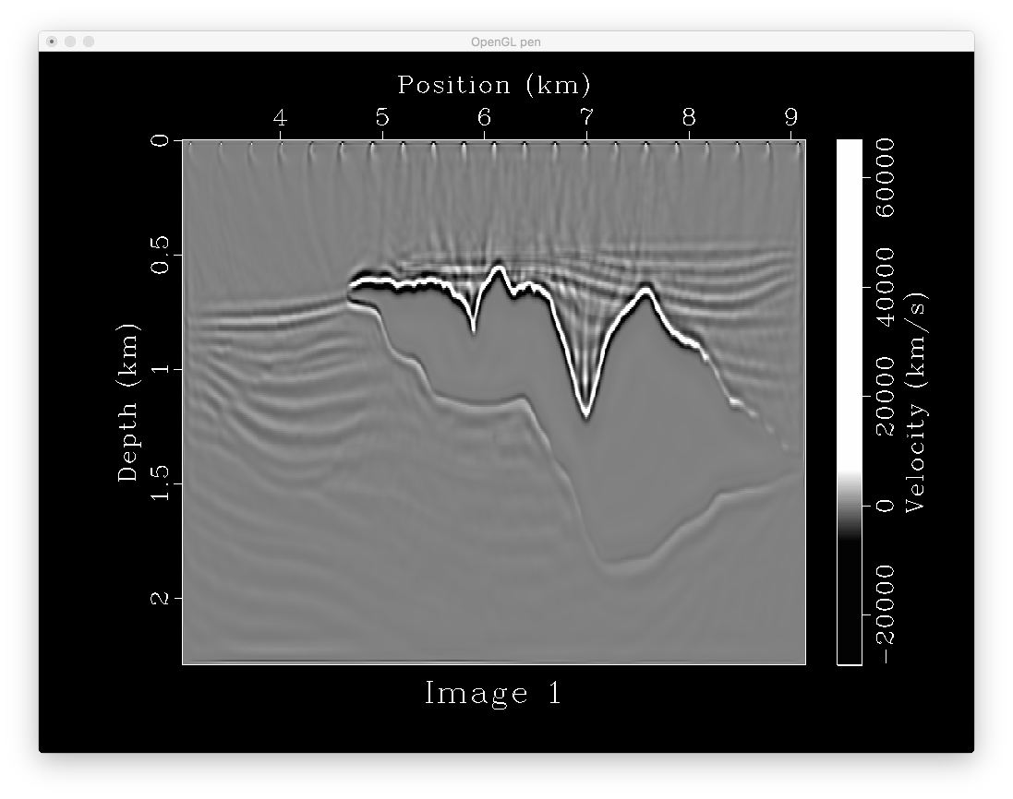
301*801
21 shots
0.0015*4000
with tpow

Slide 18
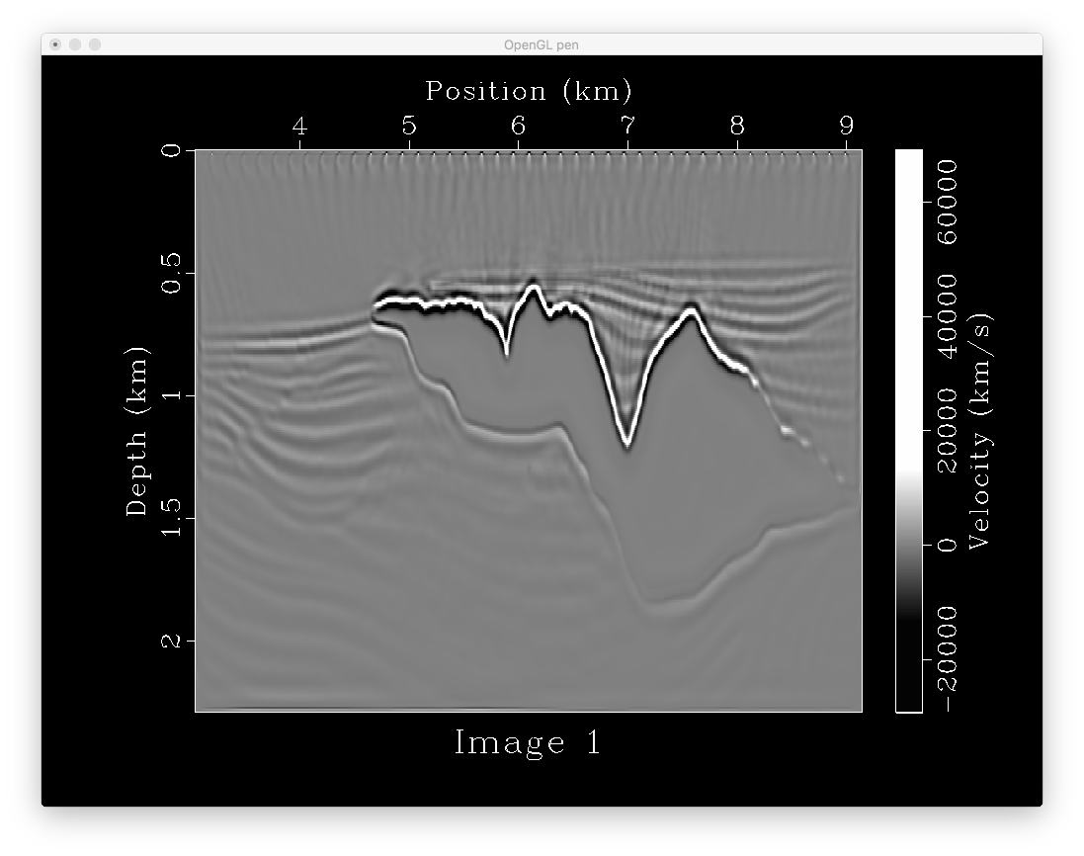
301*801
41 shots
0.0015*4000
with tpow

Slide 19
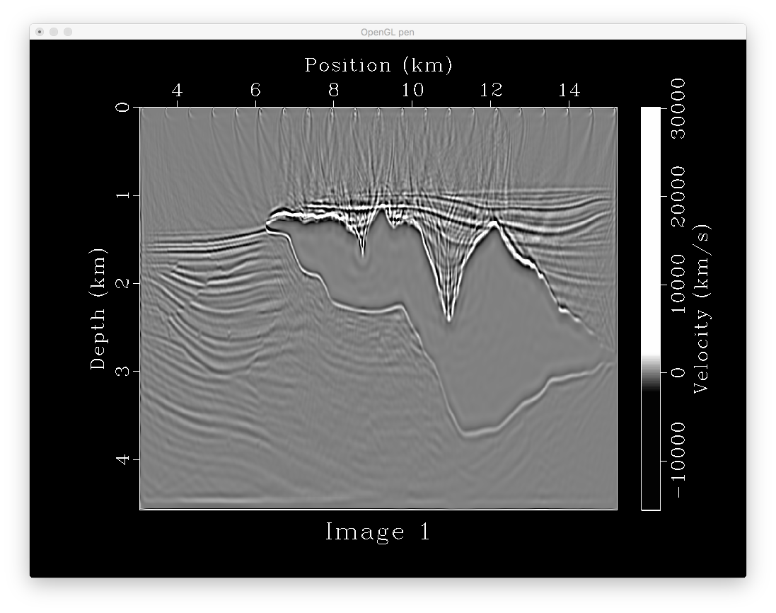
601*1601
21 shots
0.001*10000
with tpow

Slide 20
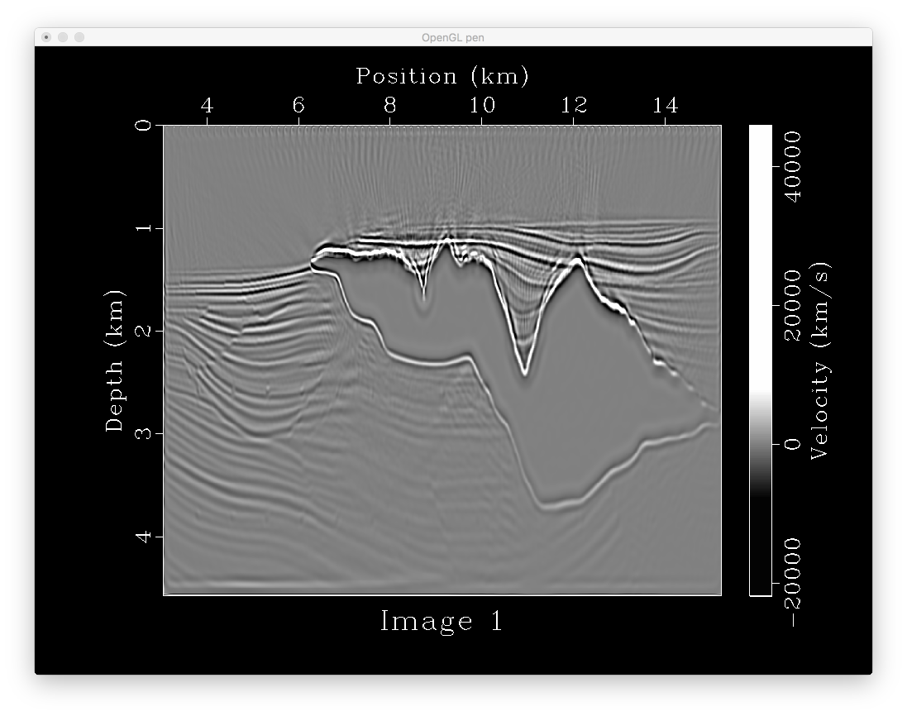
601*1601
80 shots
0.001*10000
with tpow

Slide 21
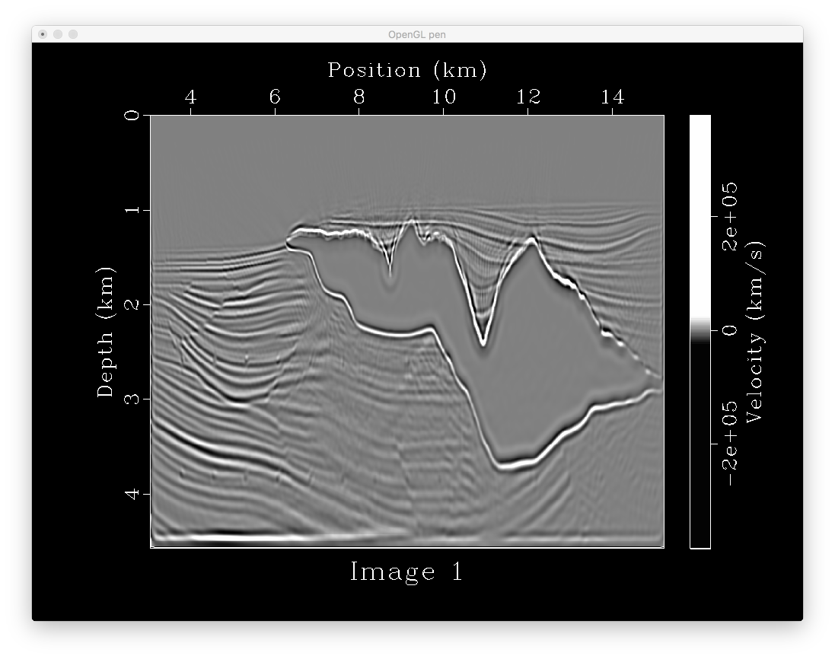
601*1601
80 shots
0.001*10000
with larger tpow

Slide 22
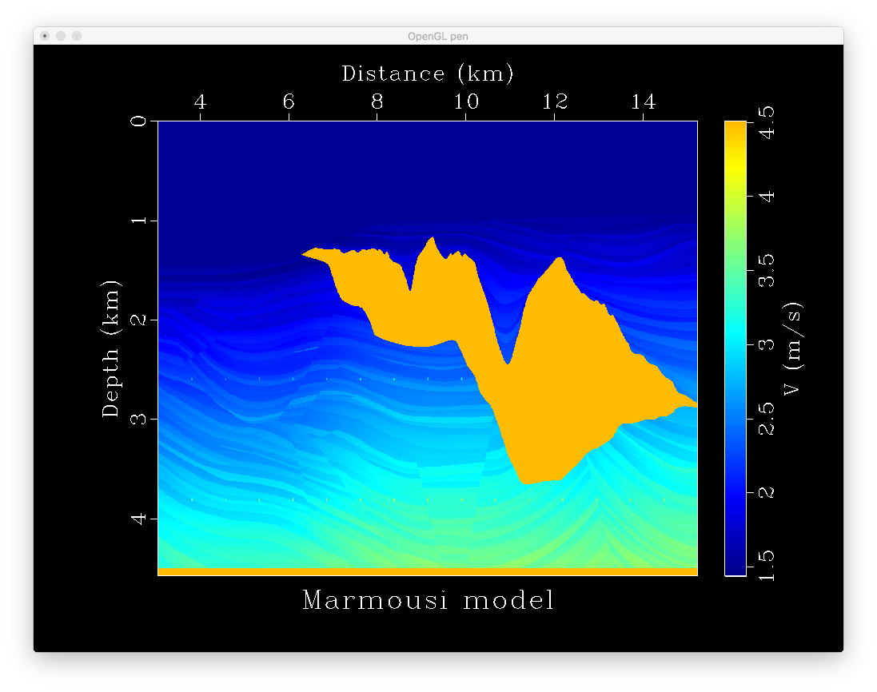

Slide 23

301*801
41 shots
0.0015*4000
without tpow

Slide 24
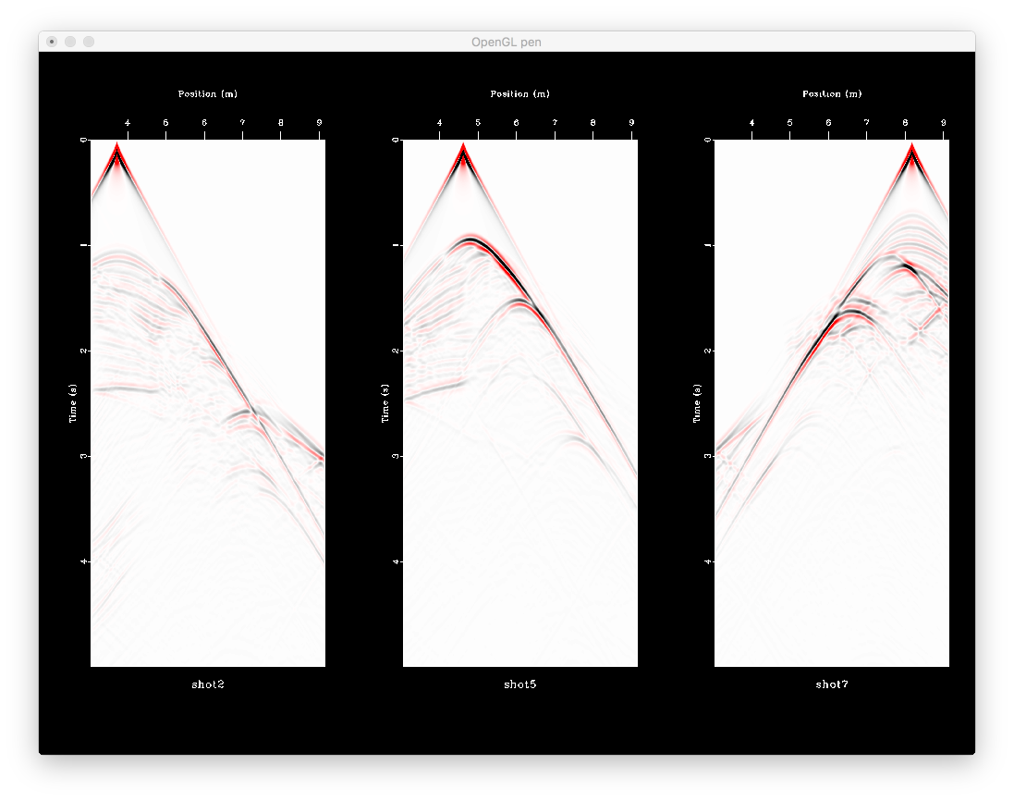

Slide 25
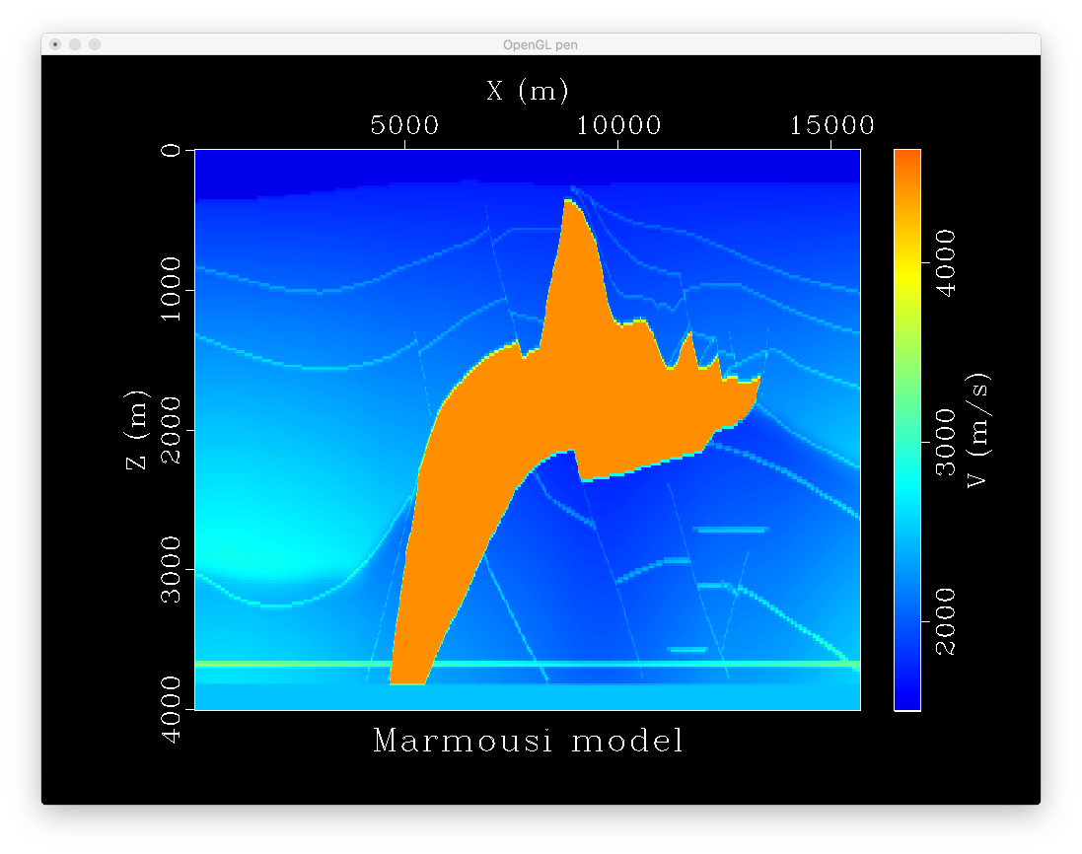

Slide 26
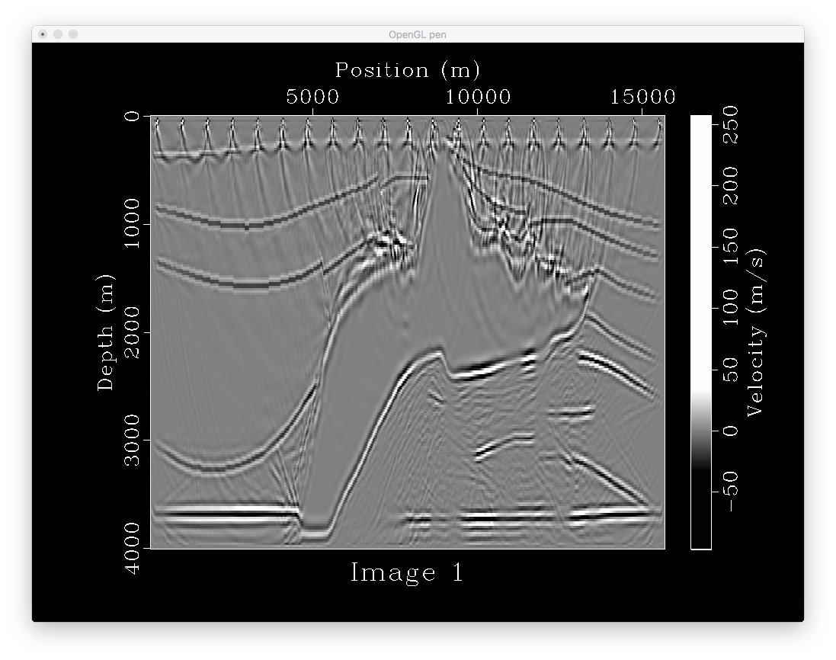
201*780
21 shots
0.0015*4000
with tpow

Slide 27
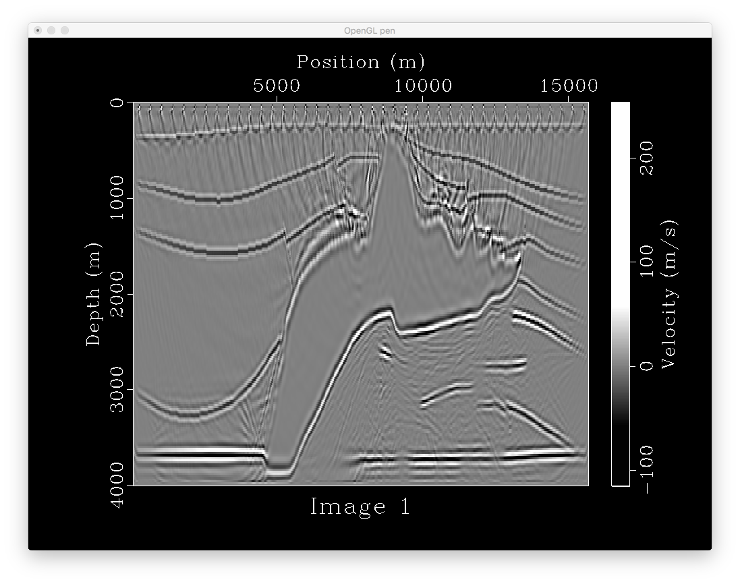
201*780
41 shots
0.0015*4000
with tpow

Slide 28
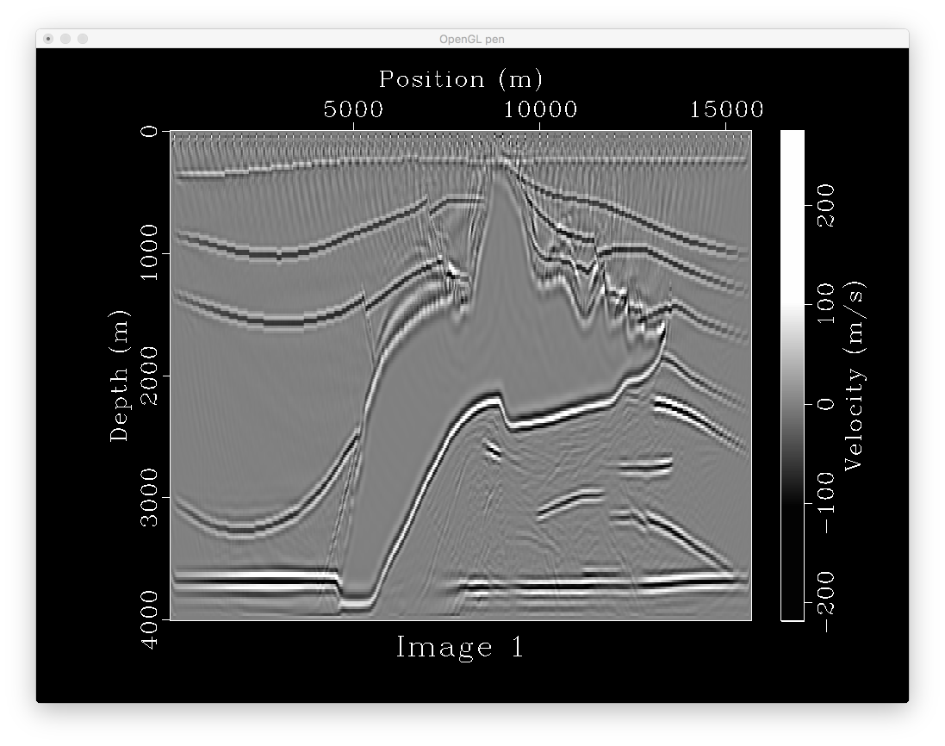
201*780
78 shots
0.0015*4000
with tpow

Slide 29
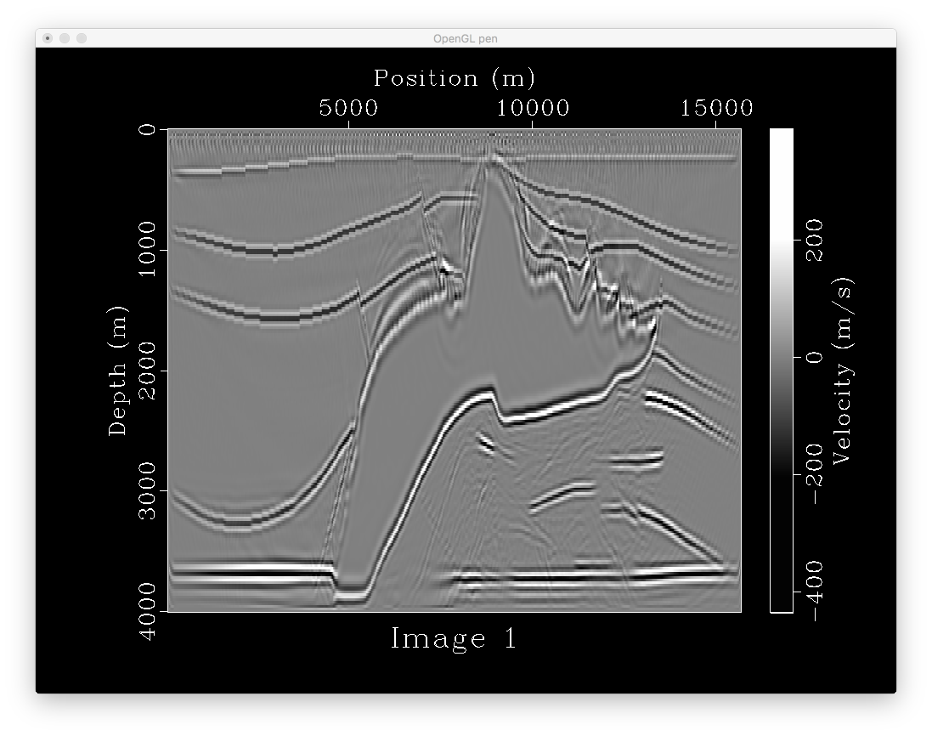
201*780
155 shots
0.0015*4000
with tpow

Slide 31
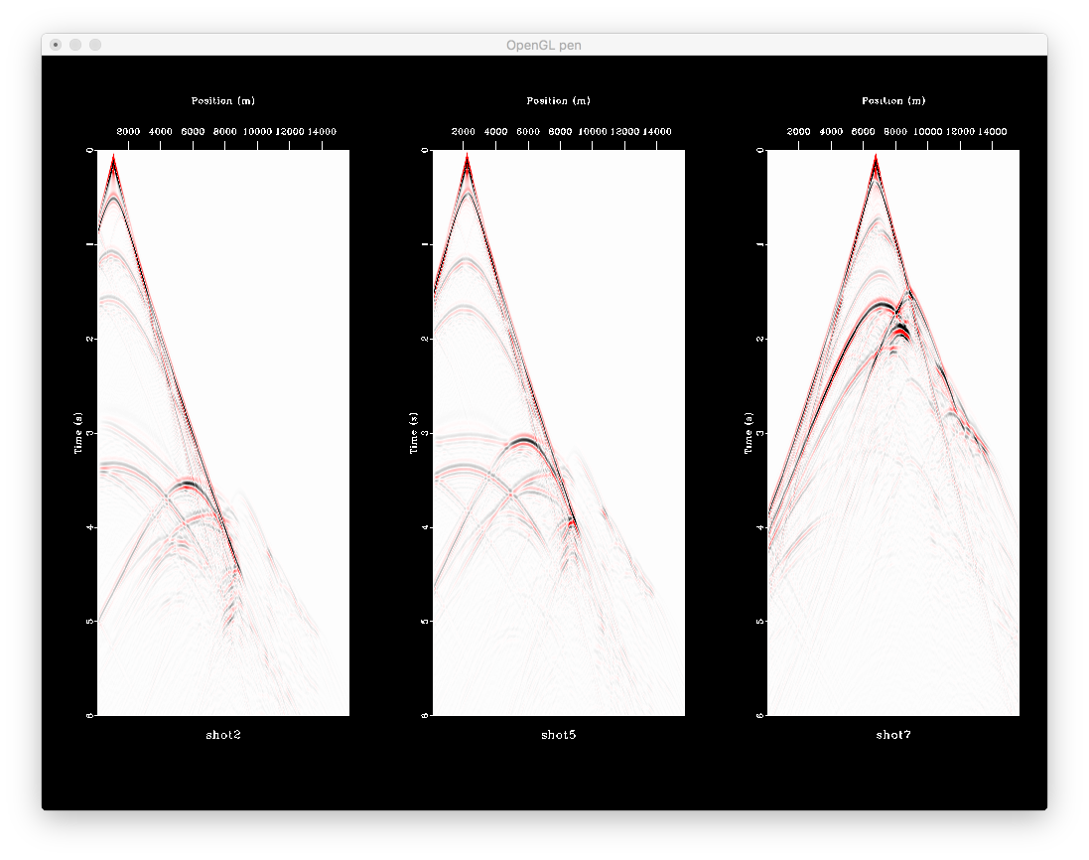

Slide 32
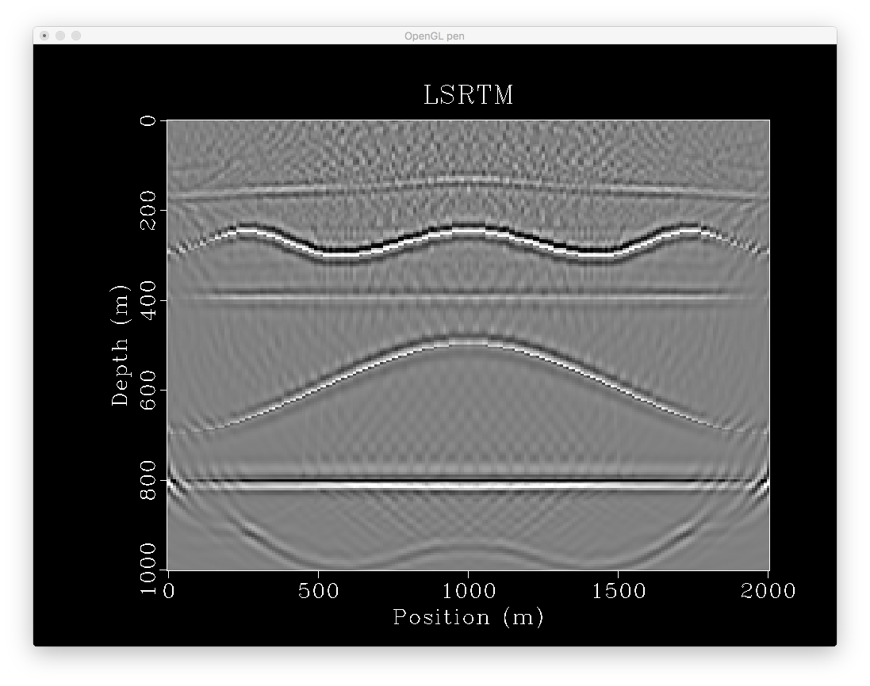
Boundary effect
Causes artifacts
On top and bottom
Of the image

